Slide 2
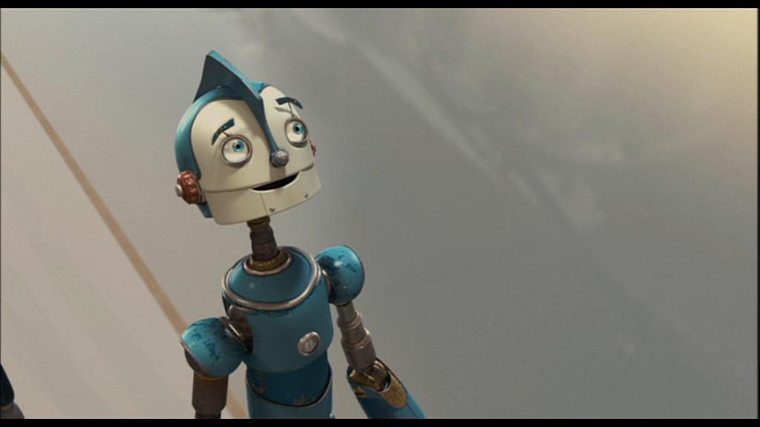
Inspiring Images
The images included here are provided, along with a range of short activities, to inspire the writer.
The activities aim to improve vocabulary acquisition, increase speaking and listening opportunities and develop sentence building skills.
The activities could be 5 minute lesson starters or used to encourage talk and writing at home.
Children should be encouraged to continue particular tasks over a number of days in order to build on the skills they are developing.

Slide 3
Inspiring Images
Although the majority of the images have a range of suggested activities - feel free to use your own ideas.
The following seven slides show activities that could be used for any of the images, but may not always be included on the suggested list, so please keep them in mind throughout, as they are all brilliant!
A thesaurus, paper and the synonym circles may also be useful resources to have within easy reach.
HAVE FUN!!
Mr Duke

Slide 4
‘OSIE’
Observation –
  What does it look like?
  Use wow words to describe it.
  What can you see when you look very closely? Focus on the detail.
  Could you use adjectives/ verbs/ adverbs to describe what you can see?
Sensation –
  Use your senses to describe what you can see, hear, smell, touch and taste.
Imagination -
  Use this category as an opportunity to write initial ideas for similes/ metaphors / personification.
  Describe what the image makes you think about.
  What else could the picture be? E.g. the rainbow was a pair of striped pyjamas.
  What does it remind you of? Does the image recall memories?
Emotion –
  Imagine you are in the scene or the character in the picture. How do you feel?
  What is your body doing?
  How does your body react when, for example in Dangle, you’re walking through the snow? You first see the rope dangling from the sky?
  How is your body changing?
  What are you thinking? What thoughts are going through your mind?

Slide 5
O S I E
Observation | Imagination
Sensation | Emotion

Slide 6
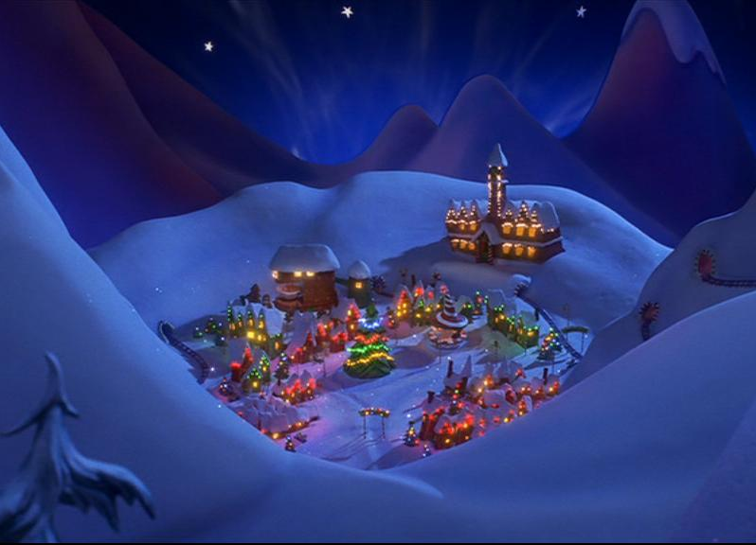
Word Waiter
What 5 things can you see? | Add a verb | Add an adverb

Slide 7
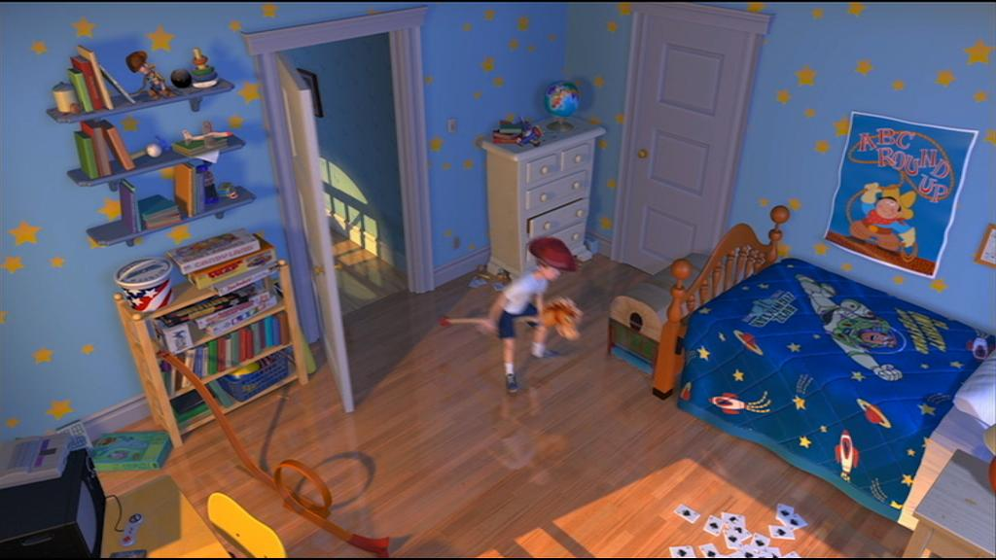
Rhinoceros Words – FS/KS1?
Why ‘Rhinoceros?’
What can you see?
Generate as many words as you can about this image. The freedom of collecting words is important – not the spelling!
Notes:
Remember Strand 5 stops in Y3.
Strand 5: Word recognition : decoding (reading) and encoding (spelling) is the exception in that it only covers objectives from Foundation Stage to the end of Key Stage 1 since the expectation is that, for the majority of children, these learning objectives will have been covered by the end of Year 2.
Strand 6 runs throughout.
The objectives for each of these aspects are grouped under 2 main headings:
Speak and listen for a wide range of purposes in different contexts
Read and write for a range of purposes on paper and on screen
Most children learn to:
retrieve, select and describe information, events or ideas
deduce, infer and interpret information, events or ideas
use syntax, context, word structures and origins to develop their understanding of word meanings
identify and comment on the structure and organisation of texts
explain and comment on writers' use of language, including vocabulary, grammatical and literary features.

Slide 8
dangerous
tense
cold
violent
amusing
threatening
funny
light-hearted
sinister
gentle
adventurous
romantic
calm
silly
scary
exciting
warm
peaceful
frightening
fast-moving
slow
sad
angry
harsh
dark
dramatic
imposing
evil
Notes:
Watch Lucky Dip and do Zone of R. activity - explain how this is a good activity to develop language

Slide 9
Useful words and phrases to reflect camera shots:
high angle Looking down… Far below… In the depths… Beneath us… | medium The boy walked over to the door… Climbing up the cliff, the boy… The two girls stared at each other… Next to the gate, the dog… | long In the distance… Surrounded by trees, the house nestled on the hill… Far away… The sunlight shone down on the streets below…
low angle Looking up at… Like a giant, she hovered over me. Staring up at… The sky above looked like… Up above… | aerial Like ants, the people below scurried around. The street raced towards him as he fell. The roads looked like a grid as I wondered where to land. | close-up Scrutinizing the ground, she… Like blades of grass in the breeze, her hair swayed… Up close… He smiled… Their hands clasped together… The door handle turned…
extreme close-up The white’s of his eyes… The hair on his neck stood on end… The grain in the wood… Scratches on the surface of the table…

Slide 10
The Cool Wall
Cool | Super-cool | Sub-zero
What time of year is it? What is the man wearing? | How do you think the man feels after pulling the rope? What do you think is happening in the town after the rope is pulled? | Why does the director use a close up shot on the man’s face when the rope has been pulled? When is a low angle shot used and what effect does it have on the viewer?

Slide 11
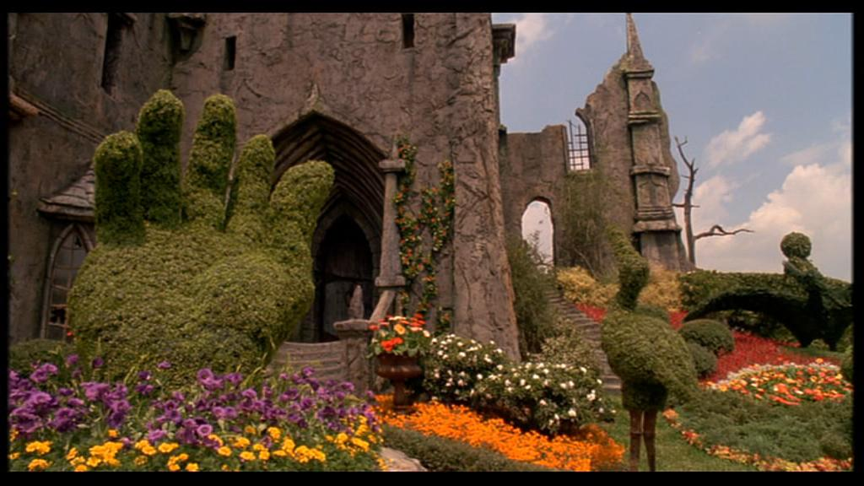
Notes:
Edward Scissorhands
What do you think this building is? Talk with a partner.
Describe the garden/building using similes/ metaphors/ personification and/or adjectives.
Who do you think lives there? Draw then describe the character.
Why is there a giant hand in the shot? Will it be important to the story?
Describe the first room you enter if you walked through the door.
Use your senses – what can you smell? What can you hear? What can you feel? What can you touch?
Use OSIE.

Slide 12
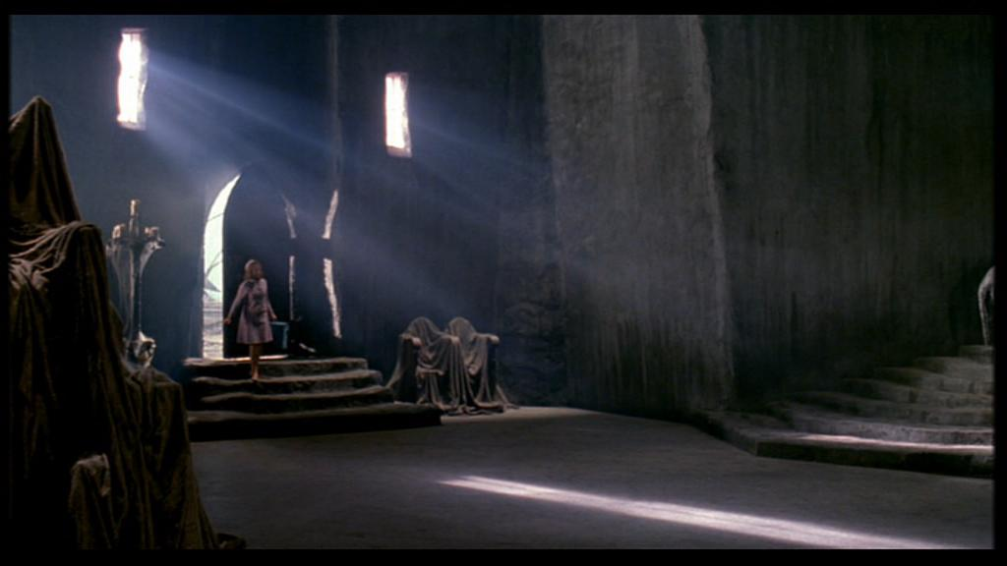
Notes:
Edward Scissorhands
Describe the room using similes/ metaphors/ personification and/or adjectives.
Describe how the lady is feeling? What is she thinking?
Who do you think lives in the house? Draw a picture and describe the character.
Where do the steps lead? Draw the room. Describe it.
Collect synonyms for dark, e.g. bleak, gloomy.
Is it cold in the hall? Collect synonyms for cold.
How would you feel walking into the hall? Describe your feelings.
Use OSIE.

Slide 13
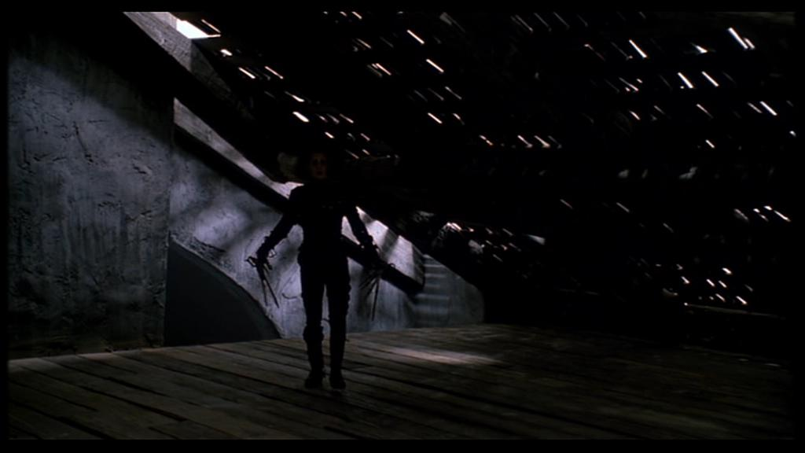
Notes:
Edward Scissorhands
Write sentences to describe the character’s hands. Use similes and metaphors.
Write a sentence to describe the sound of the footsteps. Order the words of the sentence differently but keep the same meaning.
How do you think the character is feeling?
How does the character make you feel?

Slide 14
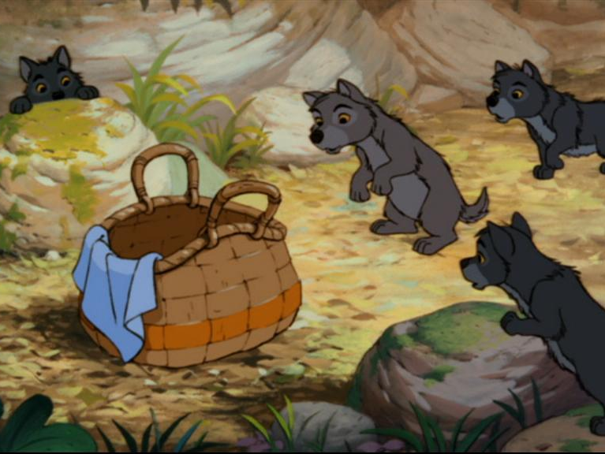
Notes:
Jungle Book
What do you think is in the basket?
What are the wolf cubs thinking? Put your ideas in thought bubbles.
Describe the scene. Include the environment, the basket and the wolf cubs.
Staring at the basket,…(finish the sentence)
Nestled between the rocks,…(finish the sentence)
Do you know any other stories which include wolves? Talk about them with a partner.

Slide 15
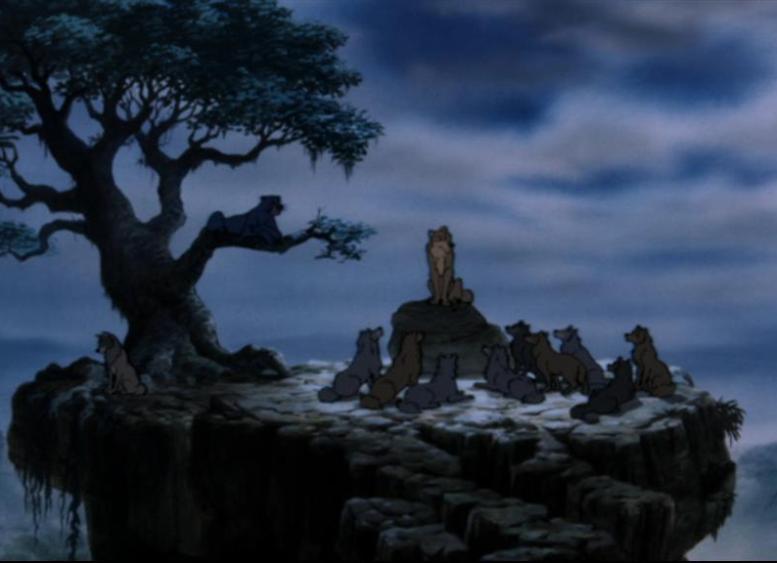
Notes:
Jungle Book
Describe the scene using similes/ metaphors/ personification and/or adjectives.Think about the time of day, temperature and your senses.
What do you think the wolves are talking about? Talk with a partner.
Why do you think one wolf is sat on his own? Write sentences to describe your ideas.
Write a sentence to show how one wolf appears to be leading the conversation. How will you show this in words?
Use OSIE.

Slide 16
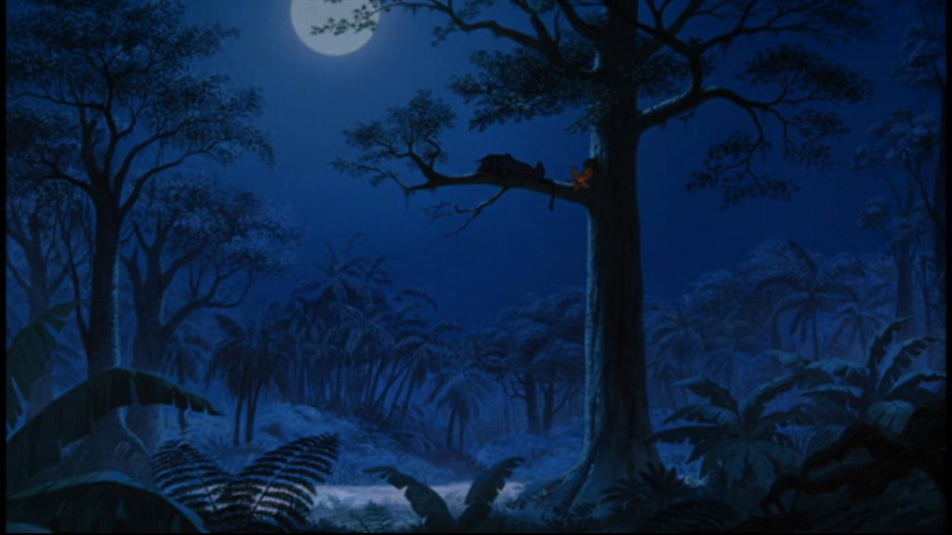
Notes:
Jungle Book
Describe the scene using similes/ metaphors/ personification and/or adjectives.Think about the time of day, temperature and your senses.
Using a thesaurus, collect synonyms for dark/sleep/blue.
Make a list of all the sounds you could here.
Use OSIE.

Slide 17
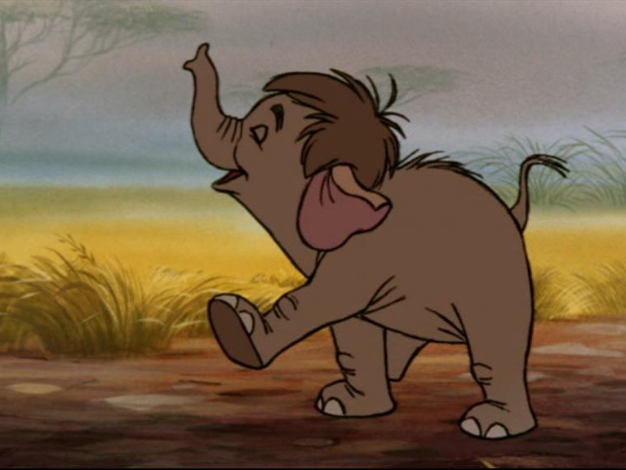
Notes:
Jungle Book
Use adjectives to describe the elephant.
Collect synonyms for walking.
Describe the scene. Include the elephant and the setting.
Why do you think the elephant is so happy? Talk with a partner.
What is the elephant thinking? Use thought bubbles.
What happens next? Write the next scene.
Do you know any other stories which include elephants? Talk about them with a partner.

Slide 18
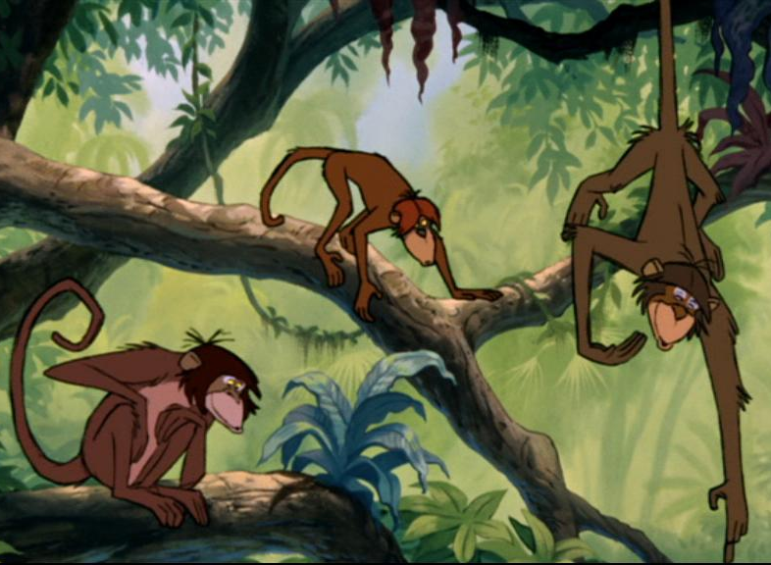
Notes:
Jungle Book
Use adjectives to describe the monkeys.
Collect synonyms for climb.
Describe the scene. Include the monkeys and the setting.
What do you think the monkey is pointing at? Talk with a partner.
Would you like to be a monkey? Explain why. Give three reasons.
Collect synonyms for the colour green.

Slide 19
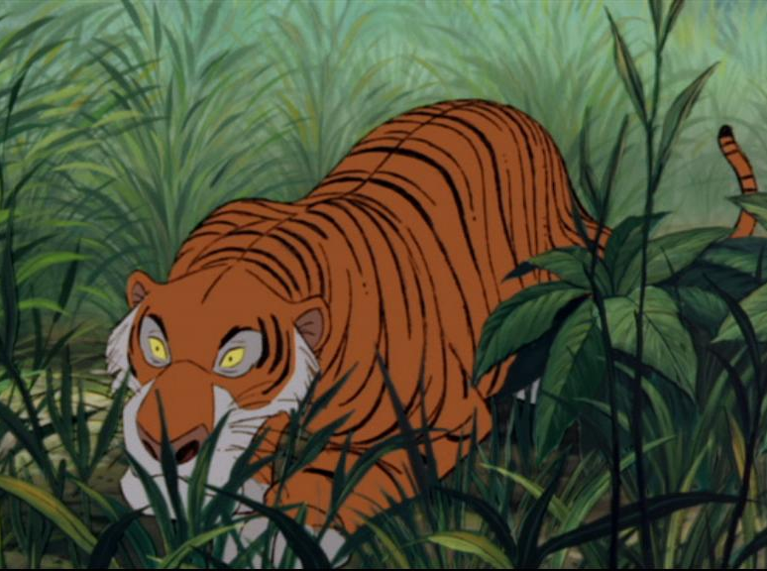
Notes:
Jungle Book
Write sentences to describe the tiger using adjectives/verbs/adverbs.
Collect adverbs to describe how the tiger is moving, e.g. patiently.
What do you think the tiger is looking at? Draw your idea.
Collect synonyms for crawl.
What is the tiger thinking? Use thought bubbles.
What happens next? Write the next scene.
Can you think of other animals with stripes? Make a list.
Can you name other members of the cat family?

Slide 20
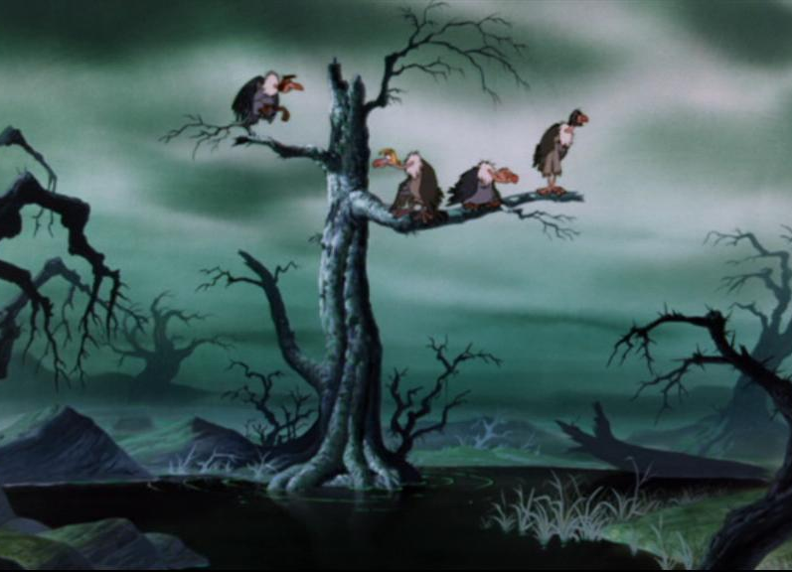
Notes:
Jungle Book
Describe the scene using adjectives, verbs and adverbs.
Describe the scene using similes, metaphors/personification, e.g. think about the branches off the trees – what do they look like?
Draw a creature that may be in the swamp. Describe it.
How does the image make you feel? Talk with a partner. How does the director achieve this?
Use OSIE.
The vultures are sitting on a branch and looking at their surroundings. Collect synonyms for sit and look.

Slide 21
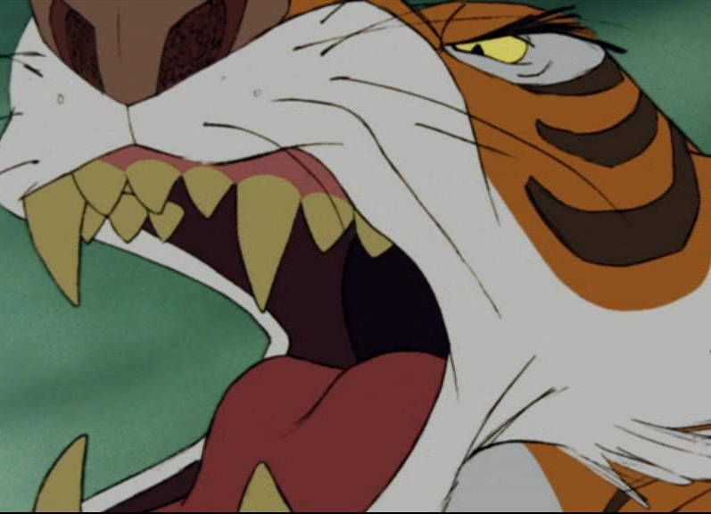
Notes:
Jungle Book
Describe the tiger’s teeth using similes/metaphors/personification.
Describe the tiger’s teeth using adjectives.
How is the tiger feeling? Use thought bubbles.
Who or what is the tiger looking at? Draw and describe.
Collect synonyms for angry, sharp and white.
Have you ever felt angry? Draw or write about it.

