Slide 1
#PICTUREBOOKS4BRITISH VALUES
A useful picture book list to support the teaching of British Values in primary school
Curated by @KarlDuke8 with thanks to @LTeacher123 for the inspiration

Slide 2
The Aim of #PICTUREBOOKS4BRITISHVALUES is to provide Teachers and schools with a selection of books – the vast majority which are picture books - linked with British values. I have included a mix of fiction, non-fiction and graphic novels throughout each category and the books cover reception to Year 6 and beyond.
The Lists are Ideas but not comprehensive. You will have your own thoughts and please follow the many regular contributors on twitter to increase your options.
we hope you find this resource useful and please Let us know if you have any further book ideas to add to the lists

Slide 3
CONTENTS
Democracy
Rule of Law
Individual Liberty
Mutual Respect and Tolerance

Slide 4

DEMOCRACY

Slide 5


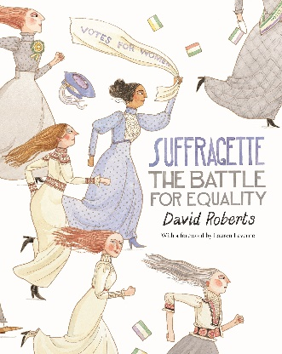




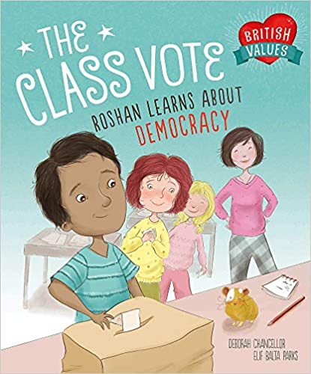



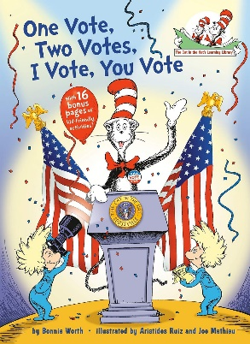

DEMOCRACY
The Little Island by Smriti Prasadam-Halls & Robert Starling
Suffragette The Battle for Equality by David Roberts
How to Build Your Own Country by Valerie Wyatt & Fred Rix
The Conquerors by David McKee
Madam President by Lane Smith
World Politics in 100 Words by Eleanor Levenson & Paul Boston (covers all Values)
The Class Vote: Roshan Learns About Democracy by Deborah Chancellor & Elif Balta Parks
Emmeline Pankhurst: Votes for Women by Kay Barnham
You Wouldn’t Want to be a Suffragette! By Fiona Macdonald & David Antram
The President of the Jungle by Andre Rodrigues, Larissa Ribeiro, Paula Desgualdo & Pedro Markun
One Vote, Two Votes, I Vote, You Vote by Bonnie Worth, Aristides Ruiz & Jon Mathieu
Sofia Valdez Future Prez by Andrea Beaty & David Roberts

Slide 6




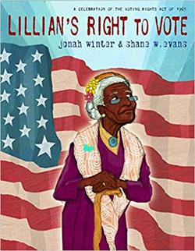

DEMOCRACY
The Election by Eleanor Levenson & Marek Jagucki
Fantastically Great Women Who Changed the World by Kate Pankhurst
We Are Water Protectors by Carole Lindstrom & Michaela Goade
Her Right Foot by Dave Eggers & Shawn Harris
Lillian’s Right to Vote by Jonah Winter & Shane W Evans
Child of the Civil Rights Movement by Paula Young Shelton & Raul Colon

Slide 7
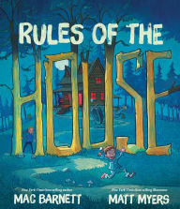
RULE OF LAW

Slide 8










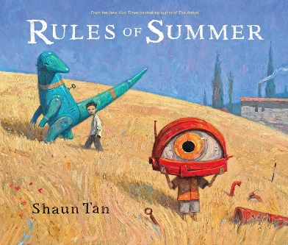
Rule of law
The Red Flag: Josh Learns About Rules by Deborah Chancellor & Elif Balta Parks
I Dissent: Ruth Bader Ginsburg Makes Her Mark by Debbie Levy & Elizabeth Baddeley
Ruth Bader Ginsburg: The Case of RBG vs Inequality by Jonah Winter & Stacy Innerst
You Must Bring a Hat by Simon Philip & Kate Hindley
Rules of the House by Mac Barnett & Matt Myers
While We Can’t Hug by Eoin McLaughlin & Polly Dunbar
Don’t Cross the Line by Isabel Minhos Martins & Bernardo P Carvalho
The Society of Distinguished Lemmings by Julie Colombet
If I Built a School by Chris Van Dusen
You Get What You Get by Julia Gassman & Sarah Horne
David Goes to School by David Shannon
Rules of Summer by Shaun Tan

Slide 9

INDIVIDUAL LIBERTY

Slide 10










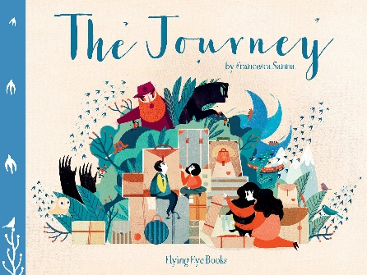






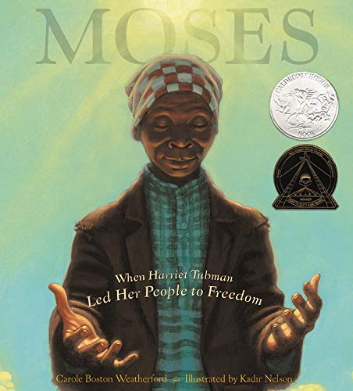

Individual liberty
Freedom, We Sing by Amyra Leon & Molly Mendoza
Every Child a Song by Nicola Davies & Marc Martin
We Are All Born Free: The Universal Declaration of Human Rights in Pictures
Counting on Katherine by Helaine Becker & Dow Phumiruk
I Have the Right to be a Child by Alain Serres, Aurelia Fronty & Sarah Ardizzone
If a Bus Could Talk: The Story of Rosa Parks by Faith Ringgold
Perfectly Norman by Tom Percival
Kamala Harries: Rooted in Justice by Nikki Grimes & Laura Freeman
Migrants by Issa Watanabe
The Journey by Francesca Sanna
Boundless Sky by Amanda Addison & Manuela Adreani
Henry’s Freedom Box by Ellen Levine & Kadir Nelson
Box: Henry Brown Mails Himself to Freedom by Carole Boston Weatherford & Michele Wood
Story Boat by Kyo Maclear & Rashin Kheiriyeh
Mary Wears What She Wants by Keith Negley
Julian at the Wedding by Jessica Love
Moses: When Harriet Tubman Led Her People to Freedom by Carole Boston Weatherford & Kadir Nelson
The Undefeated by Kwame Alexander & Kadir Nelson

Slide 11














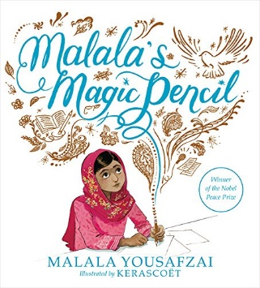

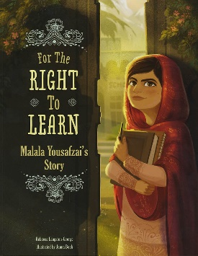
Individual liberty
My Place by Nadia Wheatley & Donna Rawlins
Yusra Swims by Julie Abery & Sally Deng
Muslim Girls Rise by Saira Mir & Aaliya Jaleel
Flight for Freedom by Kristen Fulton & Torben Kuhlmann
Dreams of Freedom in Words & Pictures
Tell Tail by C K Smouha & Katie Brosnan
What Wesley Wore by Samuel Langley-Swain & Ryan Sonderegger
Minty: A Story of Young Harriet Tubman by Alan Schroeder & Jerry Pinkney
Julian is a Mermaid by Jessica Love
Nelson Mandela: Long Walk to Freedom by Chris Van Wyk & Paddy Bouma
And Tango Makes Three by Justin Richardson, Peter Parnell & Henry Cole
We Are Family by Patricia Hegarty & Ryan Wheatcroft
Pride: The Story of Harvey Milk and the Rainbow Flag by Rob Sanders & Steven Salerno
Introducing Teddy by Jessica Walton & Dougal MacPherson
Malala’s Magic Pencil by Malala Yousafzai & Kerascoet
Malala Yousafzai: Warrior with Words by Karen Leggett Abouraya & L C Wheatley
For the Right to Learn: Malala Yousafzai’s Story by Rebecca Langston-George & Janna Bock

Slide 12


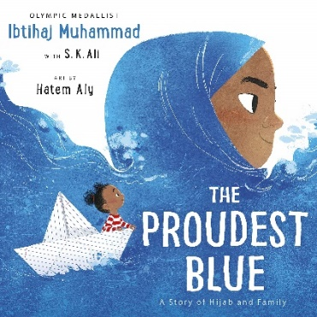







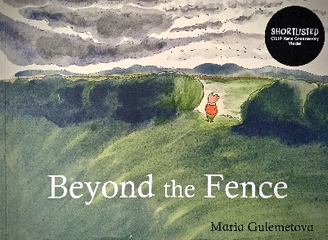








Individual liberty
Pies from Nowhere: How Georgia Gilmore Sustained the Montgomery Bus Boycott by Dee Romito & Laura Freeman
Fantastically Great Women Who Changed the World by Kate Pankhurst
The Proudest Blue: A Story of Hijab and Family by Ibtihaj Muhammad, S K Ali & Hatem Aly
Don’t Cross the Line by Isabel Minhos Martins & Bernardo P Carvalho
Sonam and the Silence by Eddie Ayres & Ronak Taher
Anne Frank: The Girl Heard Around the World by Linda Elovitz Marshall & Aura Lewis
Cicada by Shaun Tan
Goliath: The Boy Who Was Different by Ximo Abadia
The Day the Crayons Quit by Drew Daywalt & Oliver Jeffers
Weslandia by Paul Fleischman & Kevin Hawkes
Beyond the Fence by Maria Gulemetova
The Day You Begin by Jacqueline Woodson & Rafael Lopez
Caged by Duncan Annand
The Girl with Two Dads by Mel Elliott
Pink by Lynne Rickards & Margaret Chamberlain
Keith Among the Pigeons by Katie Brosnan
Born to Ride by Larissa Theule & Kelsey Garrity-Riley
Little Dreamers: Visionary Women Around the World by Vashti Harrison
HerStory by Katherine Halligan & Sarah Walsh

Slide 13





Individual liberty
The Girls by Lauren Ace & Jenny Lovlie
The Boys by Lauren Ace & Jenny Lovlie
Something Else by Kathryn Cave & Chris Riddell
For Every Child from Unicef
We’re All Wonders by R J Palacio

Slide 14

MUTUAL RESPECT & TOLERANCE

Slide 15





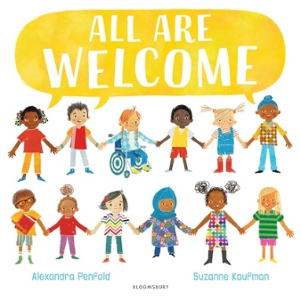











Mutual Respect & Tolerance
Two Monsters by David McKee
How to Change the World by Rashmi Sirdeshpande & Annabel Tempest
The Honey Hunter by Karthika Nair & Joelle Jolivet
Oh No, George! By Chris Haughton
All Are Welcome by Alexandra Penfold & Suzanne Kaufman
Green Lizards and Red Rectangles and the Blue Ball: A Story of Living in Harmony by Steve Antony
Inch & Grub: A Story of Cavemen by Alastair Chisholm & David Roberts
My Two Grannies by Floella Benjamin & Margaret Chamberlain
Drawn Together by Minh Le & Dan Santat
If You Come to Earth by Sophie Blackall
There’s Room for Everyone by Anahita Teymorian
Cyril and Pat by Emily Gravett
Quill Soup by Alan Durant & Dale Blankenaar
The Wall in the Middle of the Book by Jon Agee
The Day War Came by Nicole Davies & Rebecca Cobb
Under the Love Umbrella by Davina Bell & Allison Colpoys
Making Friends: Emily Learns about Tolerance by Deborah Chancellor & Elif Balta Parks

Slide 16










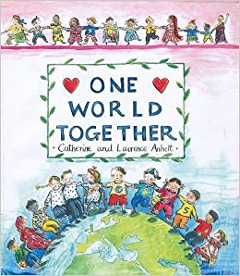
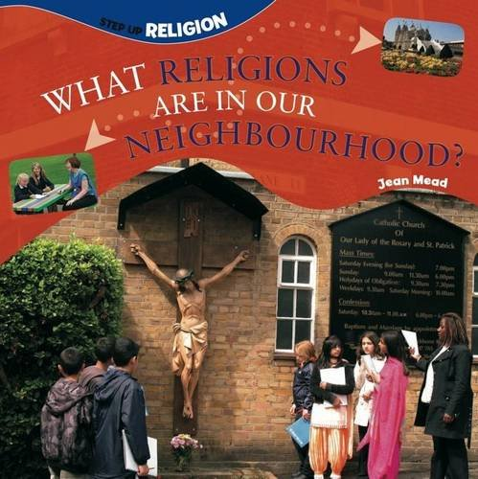





Mutual Respect & Tolerance
Leaf by Sandra Dieckmann
Pies from Nowhere: How Georgia Gilmore Sustained the Montgomery Bus Boycott by Dee Romito & Laura Freeman
Through the Wall by Jonathan Standing
War Game by Michael Foreman
The Island by Armin Greder
Colin and Lee Carrot and Pea by Morag Hood
Mixed by Arree Chung
The Smeds and The Smoos by Julia Donaldson & Axel Scheffler
The Society of Distinguished Lemmings: In a society of lemmings, can a bear ever belong? by Julie Colombet
Marney’s Mix Up by Jane Rushmore & Sally Darby
One World Together by Catherine & Laurence Anholt
What Religions are in our Neighbourhood? by Jean Mead
Frog and the Stranger by Max Velthuijs
War and Peas by Michael Foreman
Champion Gran: Kara Learns About Respect by Deborah Chancellor & Elif Balta Parks
The Name Jar by Yangsook Choi
The Other Side by Jacqueline Woodson & E B Lewis

